Slide 1

Time-Series Analysis
Monthly Number of Earthquakes
Zhengxiang Yi
Mar, 10 2020

Slide 2
Introduction
Two major earthquakes happened last July in Ridgecrest triggered a wide spread panic on future earthquakes.
Whether earthquake is predictable or at least the number of earthquakes in the future is predictable?
Warning the public, informing the research community.
2
Notes:
computational expense
FEMA P807 how to update the seismic parameters using this framework
Computational expense comparison
Evaluating the performance of the surrogate model (the ultimate goal)
Add the two or three high level slides at the last,
This has created shift the paradim how we develop seismic designs for the new buildings
Collapse loss
Detail list of possible extension
Outline
Slides

Slide 3
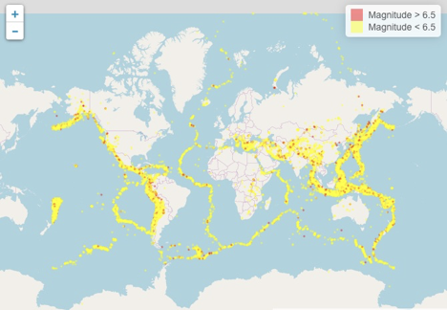
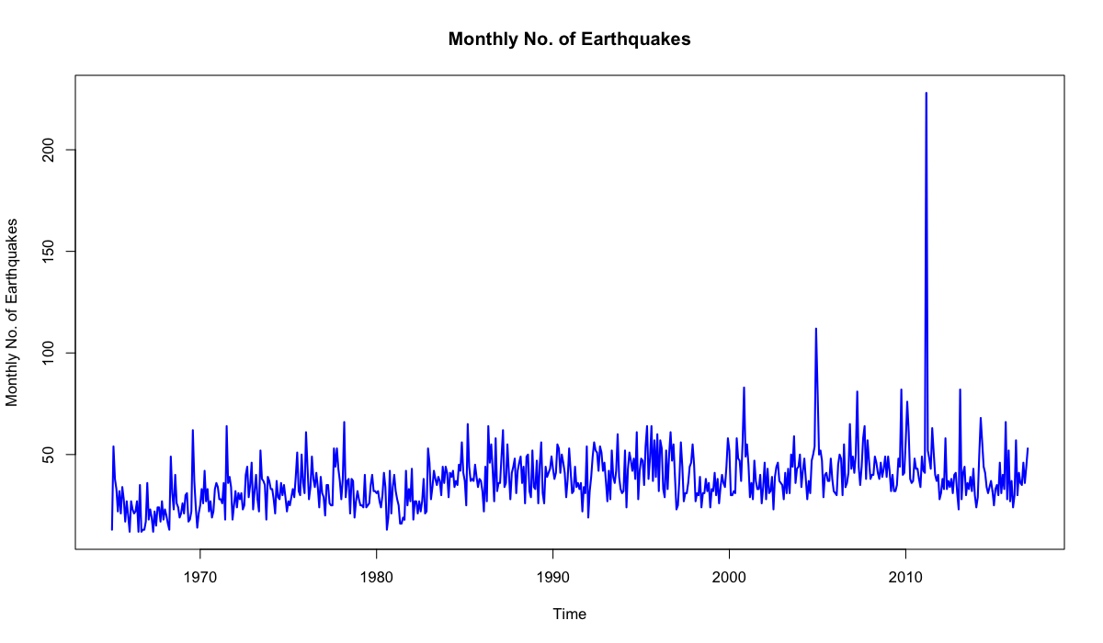
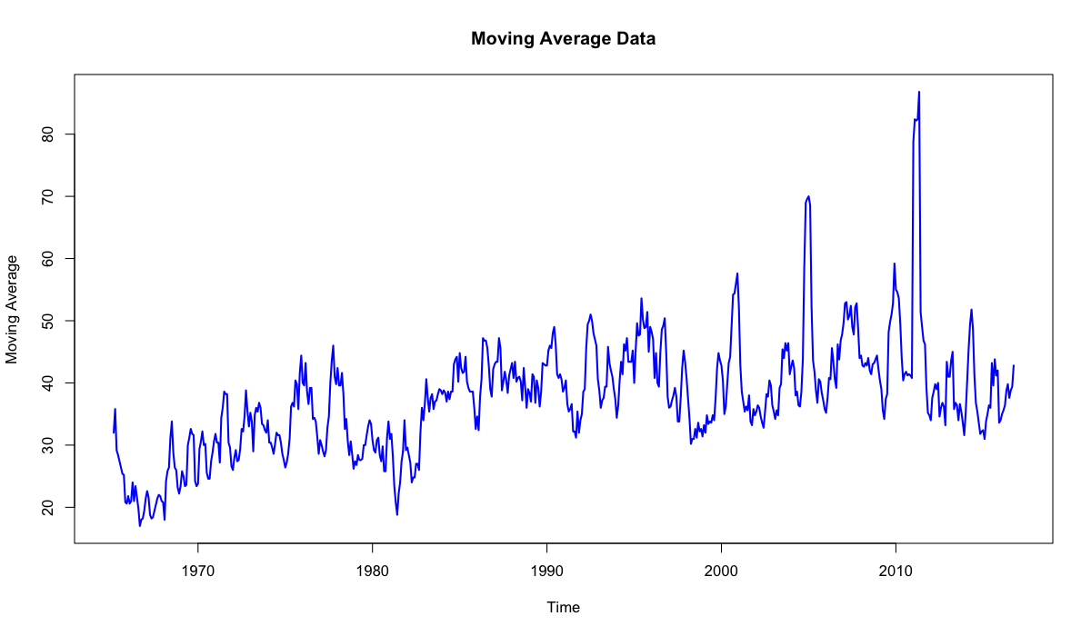
Data Description
Original data is acquired from US Geological Survey (USGS), containing detailed information of recorded greater than magnitude 5 earthquakes.
To study the trend of the earthquake activities, monthly number of earthquakes is computed from the original data.
On average, 37.5 earthquakes happen in a month.
228 earthquakes happen in Mar 2011, which is the highest month.
Slight increasing trend can be found.
3
Notes:
computational expense
FEMA P807 how to update the seismic parameters using this framework
Computational expense comparison
Evaluating the performance of the surrogate model (the ultimate goal)
Add the two or three high level slides at the last,
This has created shift the paradim how we develop seismic designs for the new buildings
Collapse loss
Detail list of possible extension
Outline
Slides

Slide 4
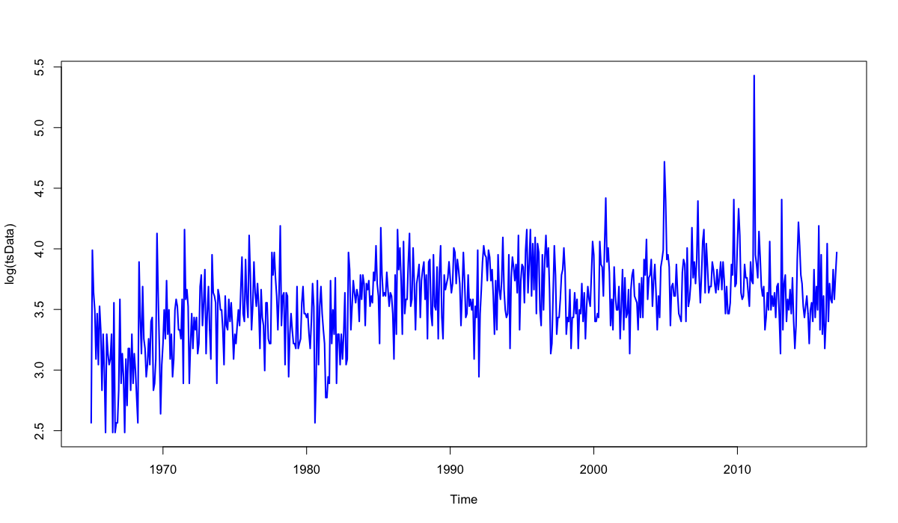
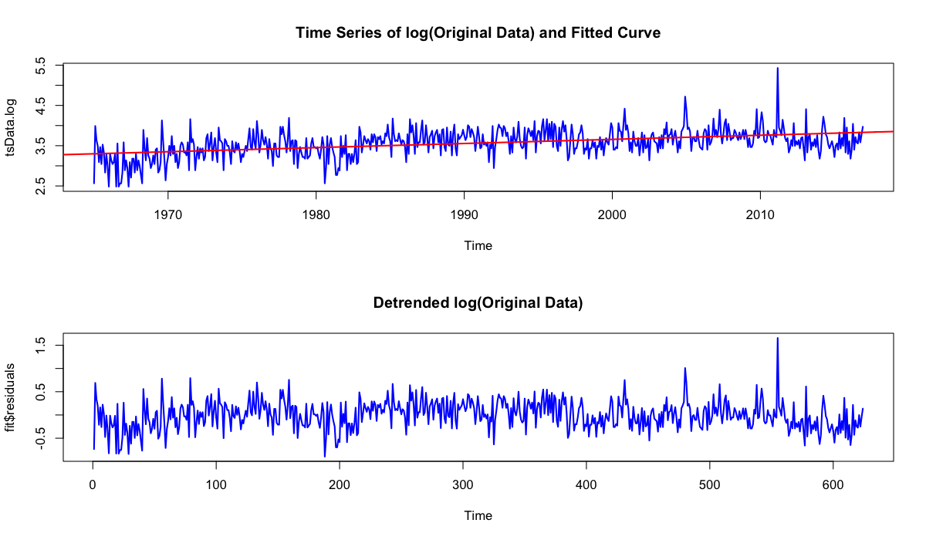
Data Cleaning
The original data shows time dependent variance, first logarithm is taken.
Increasing trend can be observe, linear regression is applied to detrend the data.
 | Estimate | Std. Error | t value | Pr(>|t|)
(Intercept) | -1.69E+01 | 1.62E+00 | -10.44 | <2e-16 | ***
time | 1.03E-02 | 8.14E-04 | 12.64 | <2e-16 | ***
4
Notes:
computational expense
FEMA P807 how to update the seismic parameters using this framework
Computational expense comparison
Evaluating the performance of the surrogate model (the ultimate goal)
Add the two or three high level slides at the last,
This has created shift the paradim how we develop seismic designs for the new buildings
Collapse loss
Detail list of possible extension
Outline
Slides

Slide 5
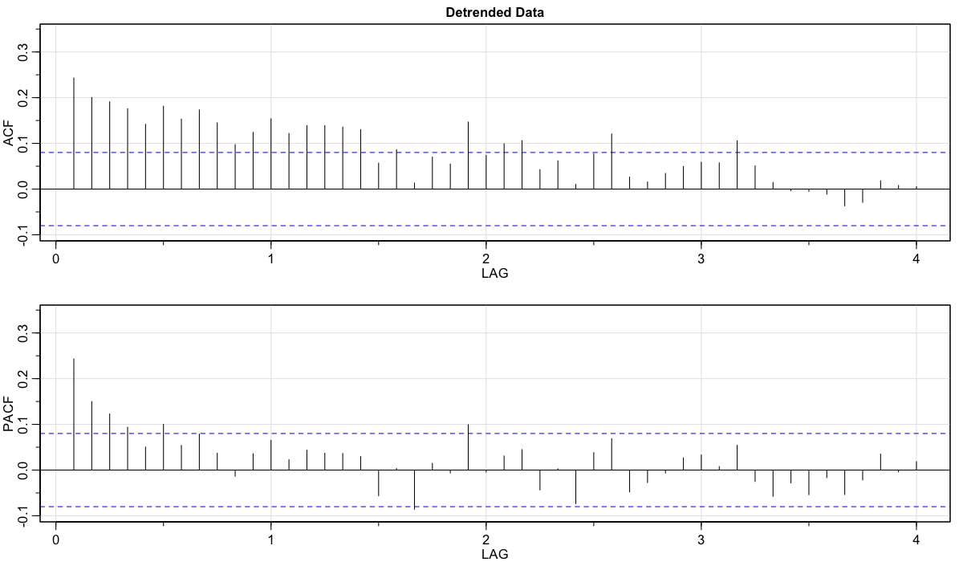
ACF and PACF
No obvious repetitive pattern can be observed from ACF and PACF.
Both ACF and PACF tail off, suggesting ARIMA model may be a good fit.
5
Notes:
computational expense
FEMA P807 how to update the seismic parameters using this framework
Computational expense comparison
Evaluating the performance of the surrogate model (the ultimate goal)
Add the two or three high level slides at the last,
This has created shift the paradim how we develop seismic designs for the new buildings
Collapse loss
Detail list of possible extension
Outline
Slides

Slide 6
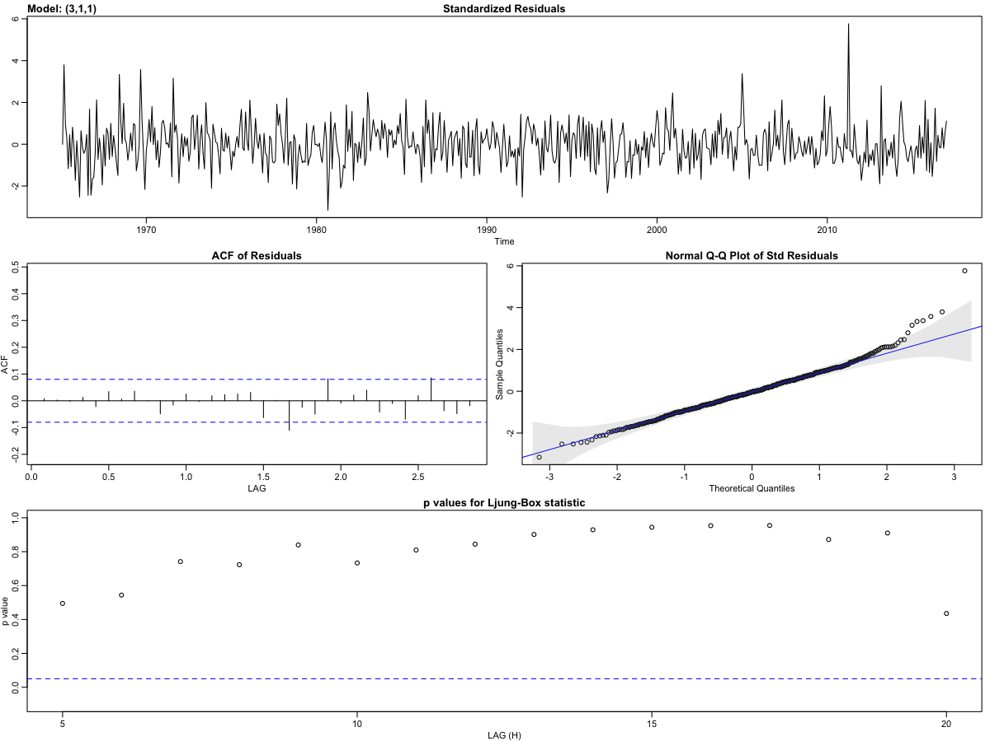
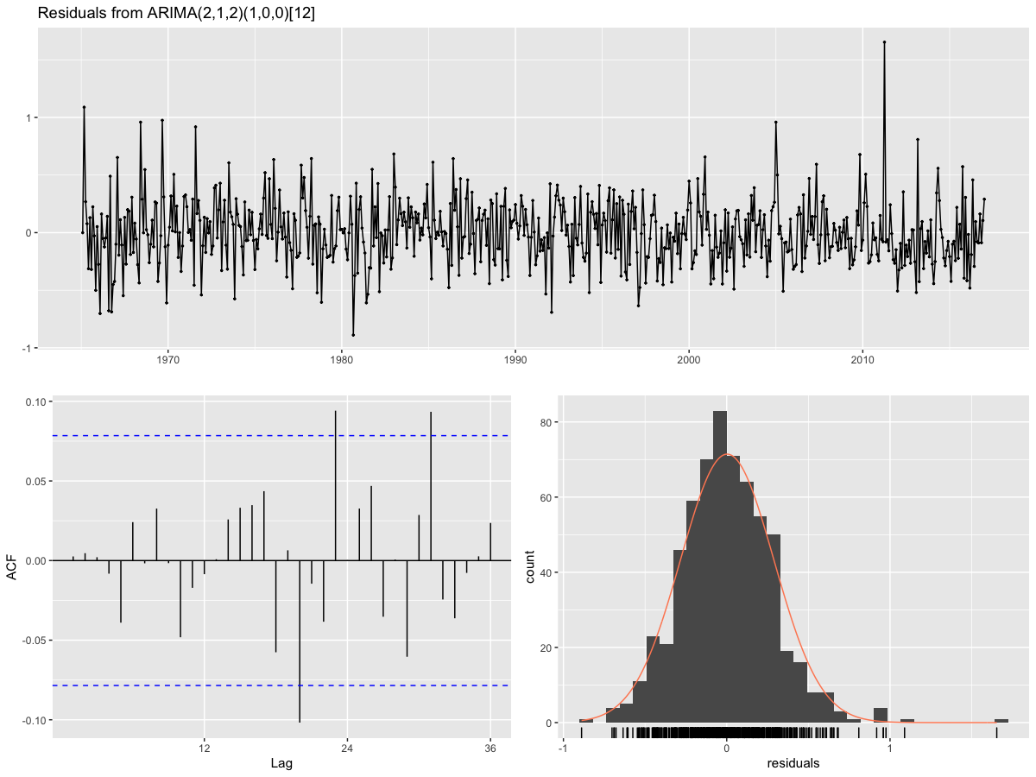
Model Fitting
ARIMA (3,1,1) is selected for the best non-seasonal model.
ARIMA (2,1,2)(1,0,0)[12] is selected for the best seasonal model.
$$\begin{aligned}&x_{t}=1.0952x_{t−1}−0.0589x_{t−2}−0.0430x_{t−3}−0.0320x_{t−4}+w_{t}−0.935w_{t−1} \#\end{aligned}$$
No significant differences
6
Notes:
computational expense
FEMA P807 how to update the seismic parameters using this framework
Computational expense comparison
Evaluating the performance of the surrogate model (the ultimate goal)
Add the two or three high level slides at the last,
This has created shift the paradim how we develop seismic designs for the new buildings
Collapse loss
Detail list of possible extension
Outline
Slides

Slide 7
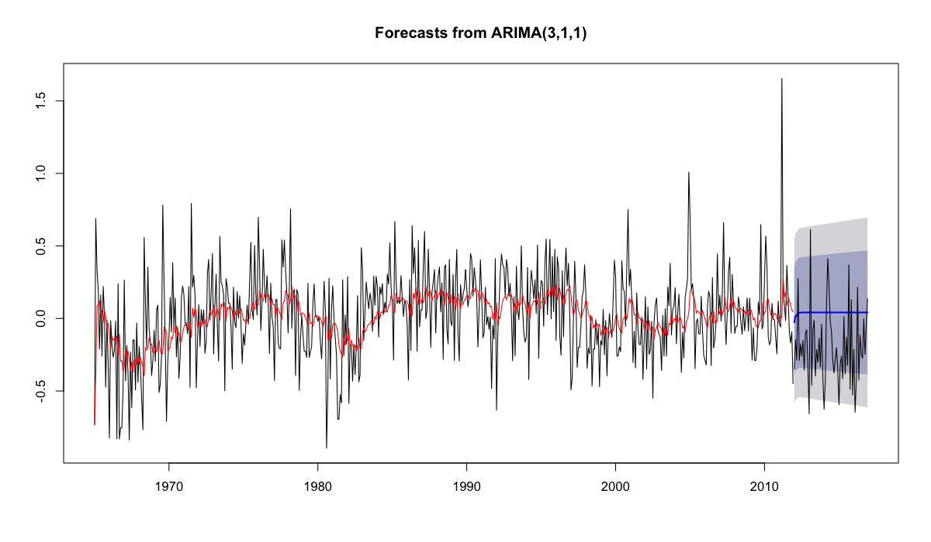

Forecasting
Data from Jan 1965 to Dec 2011 is used for training data to predict the data from Jan 2012 to Dec 2016.
Training predictions are quite similar for the two models.
Both models reveal poor forecasting ability. The prediction deteriorate to constant quickly. Seasonal model is of more fluctuation than non-seasonal model, but still poor forecasting.
7
Notes:
computational expense
FEMA P807 how to update the seismic parameters using this framework
Computational expense comparison
Evaluating the performance of the surrogate model (the ultimate goal)
Add the two or three high level slides at the last,
This has created shift the paradim how we develop seismic designs for the new buildings
Collapse loss
Detail list of possible extension
Outline
Slides

Slide 8
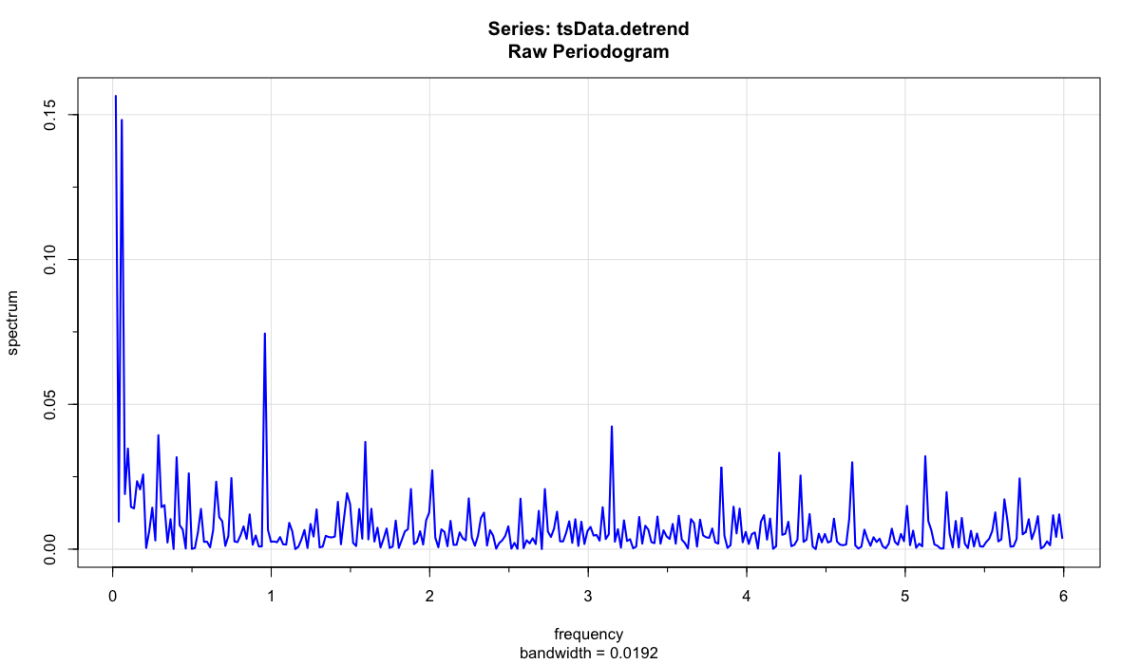
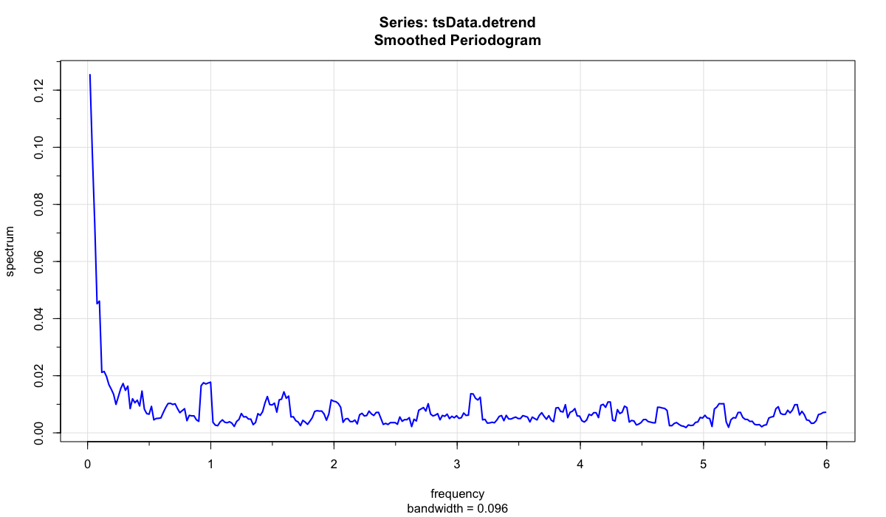
Spectrum Analysis
Three major peaks are revealed in the raw periodogram.
No significant peak can be found in the smoothed periodogram.
5% confidence interval corresponding to 12.5 month cycle is [0.025, 1.45].
So far, detrended logarithm of monthly number of earthquake performs closely to random walk.
8
Notes:
computational expense
FEMA P807 how to update the seismic parameters using this framework
Computational expense comparison
Evaluating the performance of the surrogate model (the ultimate goal)
Add the two or three high level slides at the last,
This has created shift the paradim how we develop seismic designs for the new buildings
Collapse loss
Detail list of possible extension
Outline
Slides

Slide 9
Thank You
9

